Slide 1



UNIVERSITY INSTITUTE OF ENGINEERING
COMPUTER SCIENCE ENGINEERING
Bachelor of Engineering
Design and Analysis of Algorithms(CST-311/ITT-311)
Topic: Heaps
DISCOVER . LEARN . EMPOWER

Slide 2
Learning Objectives & Outcomes
Objective:
To understand the Heap and its types.
Outcome:
Student will understand
Heap and its types

Slide 3
Heap
A Heap is a special Tree-based data structure in which the tree is a complete binary tree. Generally, Heaps can be of two types:
Max-Heap: In a Max-Heap the key present at the root node must be greatest among the keys present at all of it’s children. The same property must be recursively true for all sub-trees in that Binary Tree.
Min-Heap: In a Min-Heap the key present at the root node must be minimum among the keys present at all of it’s children. The same property must be recursively true for all sub-trees in that Binary Tree.

Slide 4
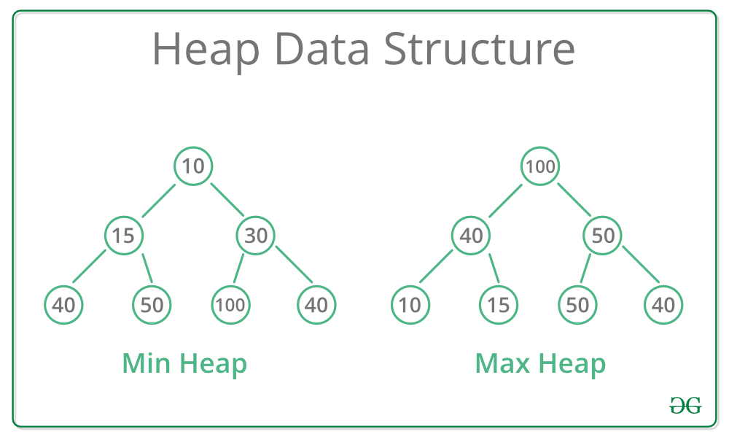

Slide 5
Methods or Operations of Heap
find - find an item in a heap.
insert - add an item in a heap ensuring the heap property is maintained min-heap and max-heap property.
delete - remove an item in a heap.
extract - return the value of an item and then delete from heap.
replace - extract or pop the root and insert or push a new item in a heap ensuring the heap property has maintained min-heap and max-heap property.

Slide 6
Methods or Operations of Heap (Contd..)
Apart from the above mentioned basic operations, there are other operations such as:
size - returns the size of heap.
is-empty - returns 'true' if heap is empty or 'false' if it has value.
merge - joining or union of two heaps, all the values from both heaps are included but the original heaps are preserved.
meld - joining of two heaps where the values from both heaps are included but the original heaps are destroyed.

Slide 7
REFERENCES
Text books:
Cormen, Leiserson, Rivest, Stein, “Introduction to Algorithms”, Prentice Hall of India, 3rd edition 2012. problem, Graph coloring.
Horowitz, Sahni and Rajasekaran, “Fundamentals of ComputerAlgorithms”, University Press (India), 2nd edition
Websites:
https://www.tutorialspoint.com/data_structures_algorithms/heap_data_structure.htm
https://www.geeksforgeeks.org/

Slide 8
Summary
Introduction to Heaps
  Basic terms
  Types of Heaps
  Max-heap
  Min-heap

Slide 9
THANK YOU

